Slide 1
Risk
Aidan Mazany
Evan Sellers
Hunter Masur
and Richard Costa

Slide 2
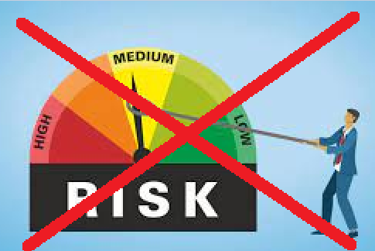
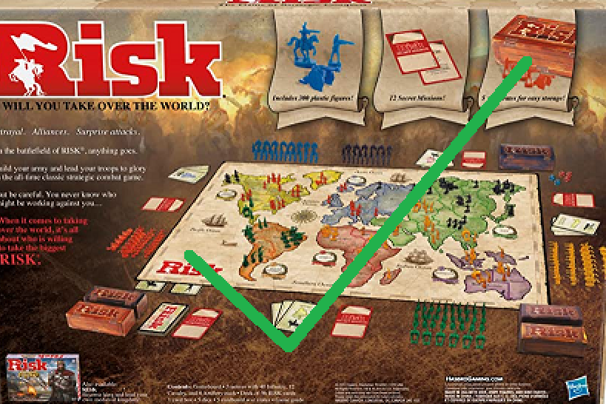
Project Introduction - What is Risk?
Risk is an easy to learn and play strategy game for 2 to 6 players, in which each player tries to conquer the world by invading territories and eliminating their opponents.
Notes:
Speaker: Hunter Risk is an easy to learn and play strategy game for 2 to 6 players, in which each player tries to conquer the world by invading territories and eliminating their opponents.
The game is played on a board divided into continents and then further divided into territories, where players take turns moving armies, attacking and defending territories, and trying to dominate the world.

Slide 3
Project Introduction - Client
Game is developed for a user base that is interested in playing Risk on the Desktop (no specific client)
Additional features were needed to evolve the game and keep user base engaged
Refactored system architecture for easy system maintenance
Notes:
Speaker: Richard
Easy modification means that whoever the client ends up being, they can modify things to suit any more specific requirements they have more easily.

Slide 4
Project Introduction - Purpose
Starting with base game from SQA
Additional features
Refactor architecture
Remove bad code smells
Improve code structure
Improve reusability
Implement continuous integration pipeline
Notes:
Speaker: Aidan
Started with basic Risk game provided by another team for SQA
vanilla “World Domination” game mode already complete
GUI is completely functional
but had a few usability issues
System architecture was not flexible
Tests written with TDD using boundary value analysis
Client requested additional features
Updated Visuals
Additional Maps
Secret Mission Mode
Wild Cards
These will be discussed further soon
Refactor architecture (All to make the the system more maintainable)
Remove bad code smells
Improve code structure
Improve reusability
Implement continuous integration pipeline

Slide 5
Project Introduction - New Key Features
Secret Mission Mode
Wild Cards
Multimap Support
Player Name And Color Selections
User/Developer Documentation
Updated Unit/Integration/Acceptance Testing
GitHub Continuous Integration Pipeline
Visually Responsive User Interface
Notes:
Speaker: Richard
Secret Mission Mode - Player if they enable this game mode, will receive a secret mission at the start of the game, like to capture a set of specific continents. If the player achieves their goal they automatically win.
Wild Cards - When a player captures a territory they will get a specific card that can be traded in later if they have a set of the correct types for more armies. The wild card can be treated as any type of army.
Multimap Support - Add the ability to add additional maps to play on at the start of the game, this adds variety to game play and requires players to develop new strategies
Player Name And Color Selections
User/Developer Documentation
Unit/Integration/Acceptance Testing
GitHub Continuous Integration Pipeline - Before a branch is merged the code must pass all unit and integration JUnit tests, as well as the Quality Ensure Tests like SpotBug and Check Style,
Multi Language Support (English/French)
Visually Responsive User Interface - Images next slide

Slide 6
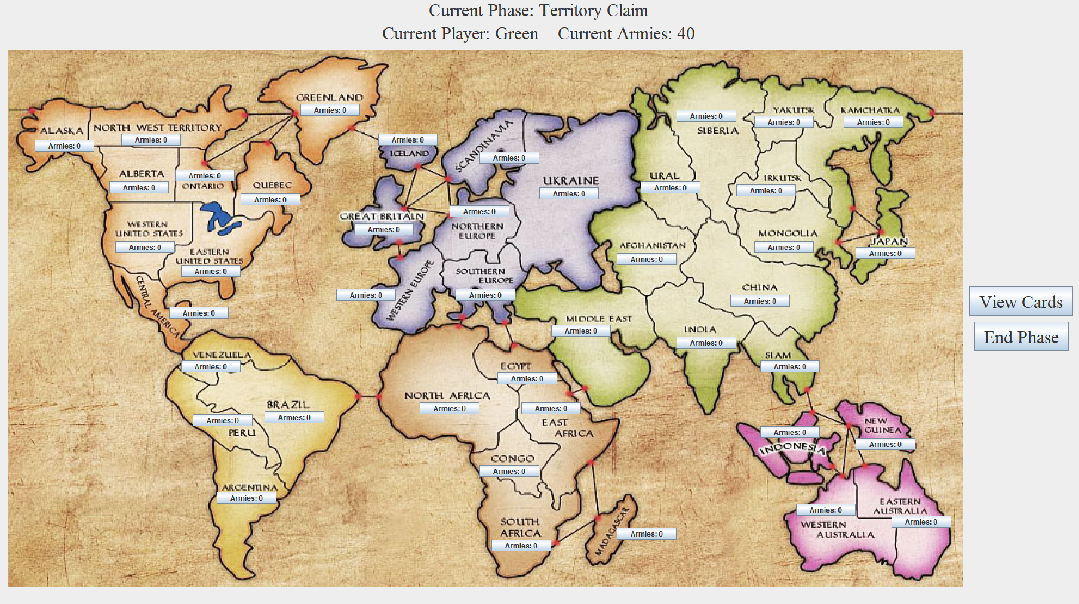
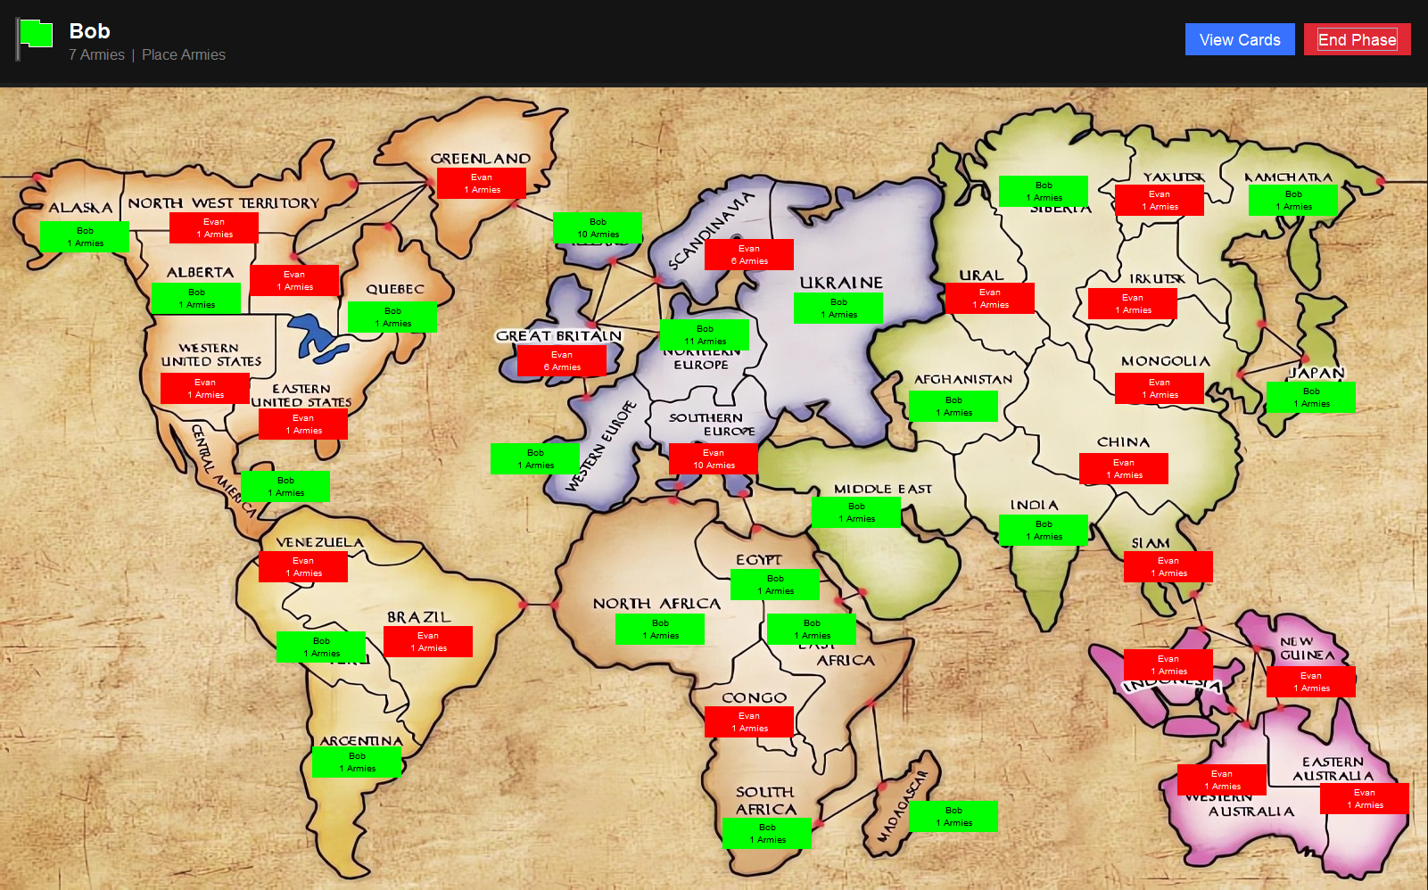
Updated Visual Interface
Original Interface
Updated Interface
Notes:
Speaker: Richard

Slide 7
Risk Board Game Demo
DEMO LINK
Notes:
Speaker: Evan

Slide 8
Interesting Challenges
Discussion

Slide 9
Implementing Additional Maps
Created abstract map representation
Removed all hard-coded references to map
Loaded map data into YAML and JPG
Map directory scanned on setup to find available map files
Notes:
Speaker: Evan
Implementing Additional Maps
Implementing Secret Missions
Abstracting Game Logic
Updating Visual Interface

Slide 10
Implementing Secret Missions
Strategy pattern employed for win conditions instead of being hard coded.
All win conditions checked at once.
Flexible implementation of new win conditions.
Notes:
Speaker: Aidan

Slide 11
Updating Visual Interface
Implement attack arrow
Create custom styled components
Implement flex-box design
Code cleanup of User Interface
Notes:
Speaker: Evan

Slide 12
Substantial Code Smells
Original project wasn’t perfect, but the code and tests were pretty clean already
Many problems of the same type (duplicate code, long methods, switch statements)
Had to reach for low-hanging fruit
Tackle the only the first of each type of bad code smell
Notes:
Speaker: Aidan

Slide 13
Questions

